Slide 1
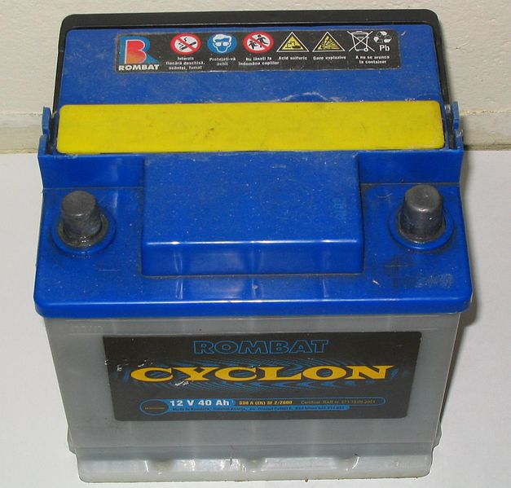
Amortized Lead Storage Batteries in Environment – Problem and Solution Ways
MENVIPRO, 2022
Assoc. Prof. Lili Arabuli
Department of Natural Sciences
School of Science and Technologies
The University of Georgia
Tbilisi, July 11-13

Slide 2
Lead Toxicity
Lead and its compounds as especially hazardous substances belong to the first class of toxic substances.
Their maximum allowable concentration (MAC) in the air doesn’t exceed 0,01mg/m³.
In the 20th century, leaded gasoline and lead-based paints were extensively disseminated in the environment. Today those sources have largely been eliminated.
According to the World Health Organization (WHO), today around 85% of the world’s lead consumption is for the production of lead-acid batteries.

Slide 3
Toxic effects of lead
Lead has no apparent physiological function. It has an affinity for sulfhydryl groups and other organic ligands in proteins and can mimic other biologically essential metals, such zinc, iron and, in particular, calcium. This enables lead to disrupt enzyme systems dependent on these ions, accounting for many of its toxic effect.
The toxic effects of lead are wide-ranging and affect almost all body systems. Acute lead poisoning from a single exposure is relatively rare and chronic poisoning is more common; however, the clinical features of poisoning are similar in both cases. The presenting signs and symptoms are very variable in both adults and children and may include gastrointestinal, haematological and neurological effects. Young children are particularly vulnerable to the neurological toxicity of lead and this is the main reason that lead is of public health concern. Lead also has toxic effects on the reproductive, endocrine and cardiovascular systems.

Slide 4
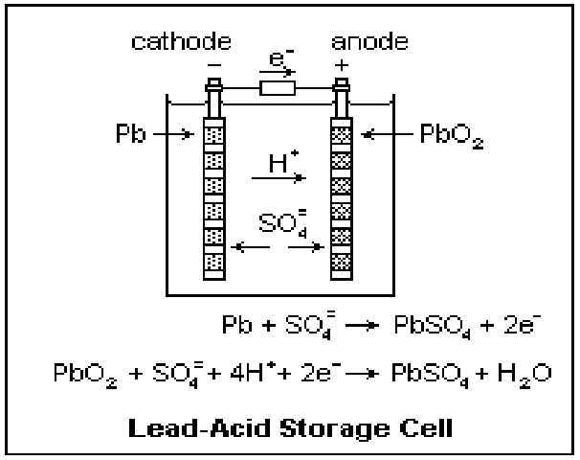
Lead Batteries – Mechanism of Operation
Lead and lead dioxide, the active materials on the plate of the battery, react to lead sulfate in the electrolyte with sulphuric acid. The lead sulfate first forms in a finely divided, amorphous state, and when the battery recharges easily returns to lead, lead dioxide, and sulphuric acid.

Slide 5
The electrodes of the cells in a lead storage battery consist of lead grids. The openings of the anodic grid is filled with spongy (porous) lead. The openings of the cathodic grid is filled with lead dioxide {PbO2}. Dilute sulfuric acid {H2SO4} serves as the electrolyte. When the battery is delivering a current, i.e.discharging, the lead at the anode is oxidized:
Pb → Pb2+ + 2 e–
Because the lead ions are in the presence of aqueous sulfate ions (from the sulfuric acid), insoluble lead sulfate precipitates onto the electrode. The overall reaction at the anode is therefore:
Pb + SO42– → PbSO4 (electrode) + 2 e–
Electrons that flow from the anode simultaneously reduce the lead dioxide at the cathode:
2 e– + PbO2 + 4 H+ →Pb2+ + 2 H2O
Again, the lead ions that are formed react with aqueous sulfate ions to form insoluble lead sulfate on the electrode, and the overall reaction at the cathode is:
2 e– + PbO2 + 4 H+ + SO42– PbSO4 (electrode) + 2 H2O

Slide 6
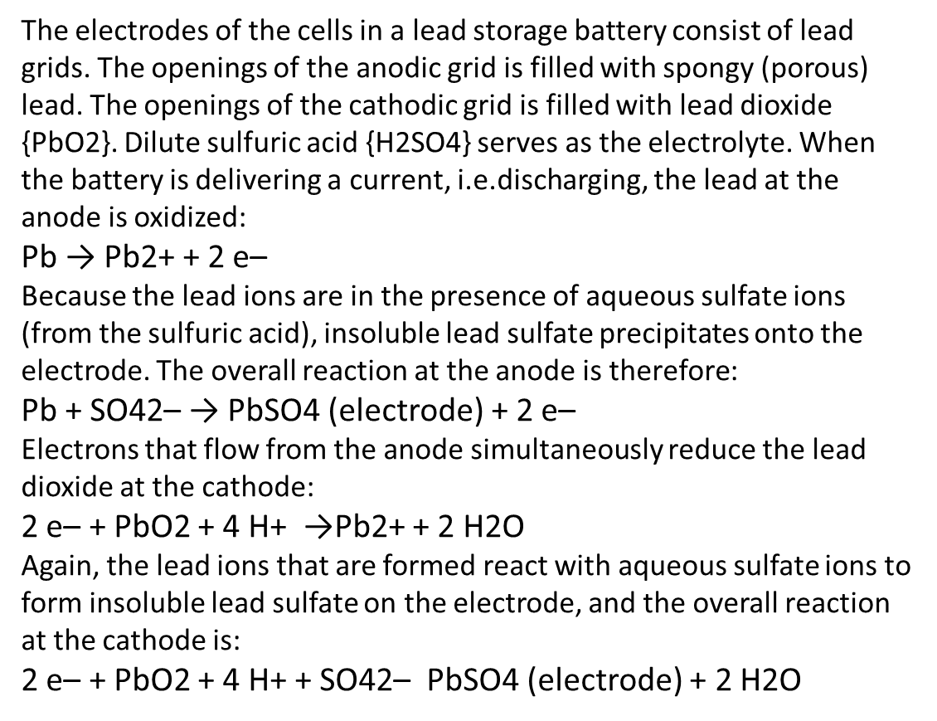
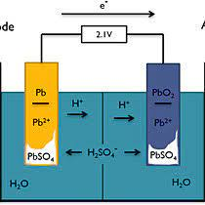
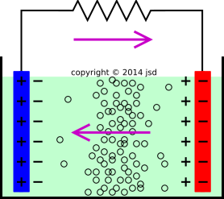
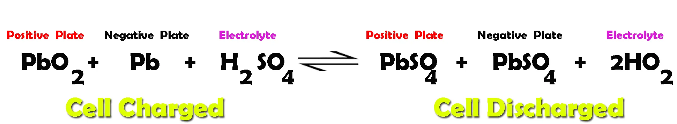

Slide 7
The chemical reaction that takes place when the lead-acid battery is recharging
Negative:
2e– + PbSO₄(s) + H₃O⁺(aq) –> Pb(s) + HSO₄– + H2O(l) (reduction)
Positive:
PbSO₄(s) + 5H₂O(l) –> PbO₂(s) + HSO₄–(aq) + 3H₃O⁺(aq) + 2e– (oxidation)

Slide 8
What countries are most affected by lead poisoning?
The report features five country case studies where lead pollution and other toxic heavy metal waste have affected children. These are Kathgora, Bangladesh; Tbilisi, Georgia; Agbogbloshie, Ghana; Pesarean, Indonesia; and Morelos State, Mexico.

Slide 9
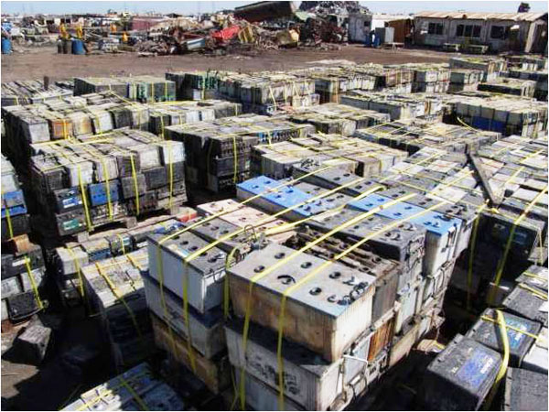
The recycling process
Once the batteries are collected, they are taken to a hammer mill where they are broken apart.
The main parts of lead-acid batteries are lead, plastic coating known as polypropylene, and sulphuric acid.
The sulphuric acid is neutralised and turned into sodium sulphate, which is used to make fertiliser and detergent.
The lead and polypropylene parts are separated by putting the broken battery pieces into a vat, where the lead falls to the bottom and the plastic materials float.
The plastic pieces are then collected, and the liquid is drained off from the vat to retrieve the lead.
Both the lead and plastic casings are then recycled into new batteries or used in other industrial products.

Slide 10
At present two basic options of recycling of amortized lead storage batteries are known:
The melting of the entire monoblocks released from acid in the presence of some reducing agent in the furnaces of different kind;
(At that time during reprocessing of 1 ton of scrap is emitted 25000 -30000m³ of air mixture (CO, CO2, SO2, gas mixtures of chlorine etc)
Preliminary mechanical dismantling of monoblocks and further reprocessing of obtained (organic, metallic and oxide-sulphate) semi-products by means of pyrometallurgical, hydrometallurgical and hydro-electro-metallurgical operations.
(The process scheme is characterized with multistage nature, volume- and energy-consuming technological processes and the necessity of toxic reagents’ application. Namely: removal of organic fraction occurs before metallurgical transformations with the use of hydrostatical and hydrodynamic operations; getting of lead from metallic fraction (Pb-Sb alloy) is carried out in molten electrolyte by means of electrochemical refinement; several schemes of reprocessing of oxide-sulphate fractions (PbO, PbO2, PbSO4) are offered)

Slide 11
After geopolitical changes happened, in post –Soviet republics a lot of enterprises has been founded voluntarily and in unclear situation, in which reprocessing of storage-batteries scrap occurs. The most part of these enterprises doesn’t meet the requirements established by ecological norms, is not equipped by gas handling and treating facilities. The rules of production waste storage and isolation are not observed, and collection and utilization of electrolyte doesn’t occur.
The composition of amortized lead storage batteries stipulates the necessity of elaboration of such technological schemes of their reprocessing that will provide maximum environmental safety and economic efficiency. This is depended to a great extent on the factors, such as: quantity of raw materials, territorial distribution, accessibility of energy carriers, and market demand for marketable co-products obtained in the manufacturing process etc.

Slide 12
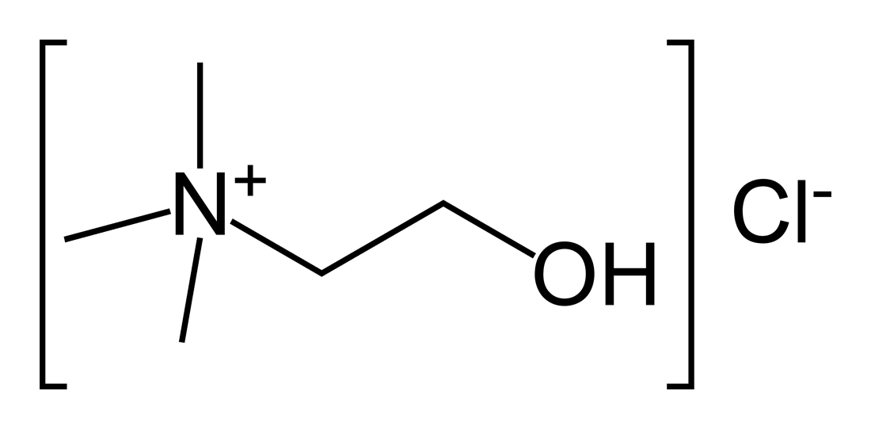
Reducing agents, used in the Recycling process:
coke, natural gas, direct current, (choline chloride)
(use of carbon (coke, C) as a fuel leads to the generation of CO₂. The high energy demand in conjunction with the production of CO₂ means that lead smelting has a comparatively high global warming potential (GWP).
The first type of chemical reaction
converts PbO (PbO2) into Pb through a
reduction process:
2 PbO + C → 2 Pb + CO2
PbO2 + C → Pb + CO2
The second type converts PbSO4 into
PbS, again through a reduction process:
PbSO4 + 2 C → PbS + 2 CO2
Finally PbS is converted into Pb through the following reactions:
PbS + Fe → Pb +FeS or
PbS + 2 PbO → 3 Pb + SO2
PbS + PbO2 → 2 Pb + SO2

Slide 13
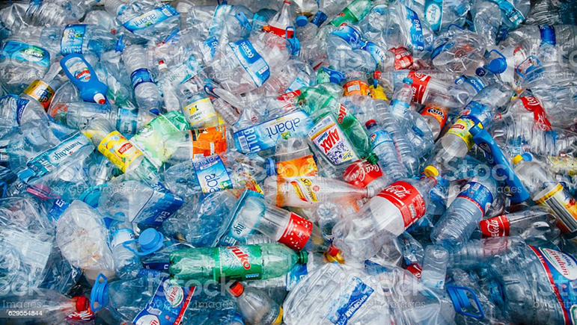
The proposed project
Waste for Waste Technology
We are developing the project for recycling of Lead from batteries or any its oxidized forms (PbO, PbO2, PbS, PbSO4) which could be the reason of contamination of soils, water etc. using domestic plastic waste as reducing agents for recovery of metallic Lead.
This will have double benefit to solve contaminating problems from Lead and plastic waste.

Slide 14
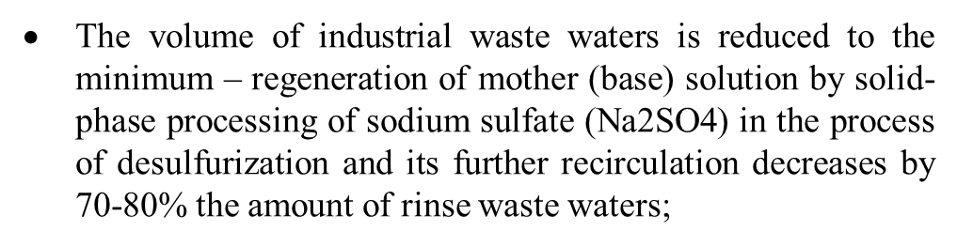
The Novelty of the Technological Offer - Domestic Plastic Waste materials as reducing agents
The application of cheap and accessible secondary raw materials (domestic polymer wastes) in the finishing operation (for reduction of lead from lead oxide, sulphate) instead of expensive reagents and materials (coke, natural gas, direct current); carrying out of reduction process in the continuous mode at relatively low temperatures 700-800°C instead of 1000-1300°C substantially reduces production prime cost and increases the economic efficiency of the production;

Slide 15
Table of comparison of amortized lead storage batteries according to different recycling technologies

Slide 16
Thank you for you attention!
We hope to find and share our common ideas fur our future cooperation!

